Slide 1

Guided Arm Build
Akbar Q – Mechatronics Engineering
Notes:
1

Slide 2

The Assignment
You are a Junior Engineer working for a leading automation company. Your team has been tasked with designing an Automated Pick-and-Place System for a manufacturing client. The client requires a system that is efficient, cost-effective, and reliable. To meet their needs, you must examine how pneumatic and hydraulic systems are applied across industries and optimize the design of the robotic arm system.
20XX
Contoso business plan
2
Notes:
2

Slide 3
Assignment summary
Design Justification
Design Optimization
Reliability and Maintenance
20XX
Contoso business plan
3
Notes:
3

Slide 4
Design Justification
The client has asked you to justify your selection of sensors and actuators for the robotic arm. They want to understand why you chose specific components over alternatives, especially considering cost constraints. You’ll need to explain how your choices align with the system’s operational requirements and provide value to the client.
20XX
Contoso business plan
4
Notes:
4

Slide 5

Design Optimization
During testing, your team identifies some limitations in the robotic arm’s performance. The client expects you to propose design modifications to the control system to improve efficiency and effectiveness. Using MATLAB-Simulink or ROS simulations, you’ll demonstrate how these changes address the limitations and enhance functionality.
20XX
Contoso business plan
5
Notes:
5

Slide 6

Reliability and Maintenance
The client emphasizes the importance of reliability and minimal downtime. They’ve asked you to incorporate maintenance techniques into the system design to extend its service life and prevent failures. Your goal is to ensure the system is not only functional but also easy to maintain, with preventive measures in place to avoid unexpected breakdowns.
20XX
Contoso business plan
6
Notes:
6

Slide 7


Moodle Access
20XX
Contoso business plan
7
Notes:
7

Slide 8
https://wincedu.net/moodle/
8
Notes:
8

Slide 9

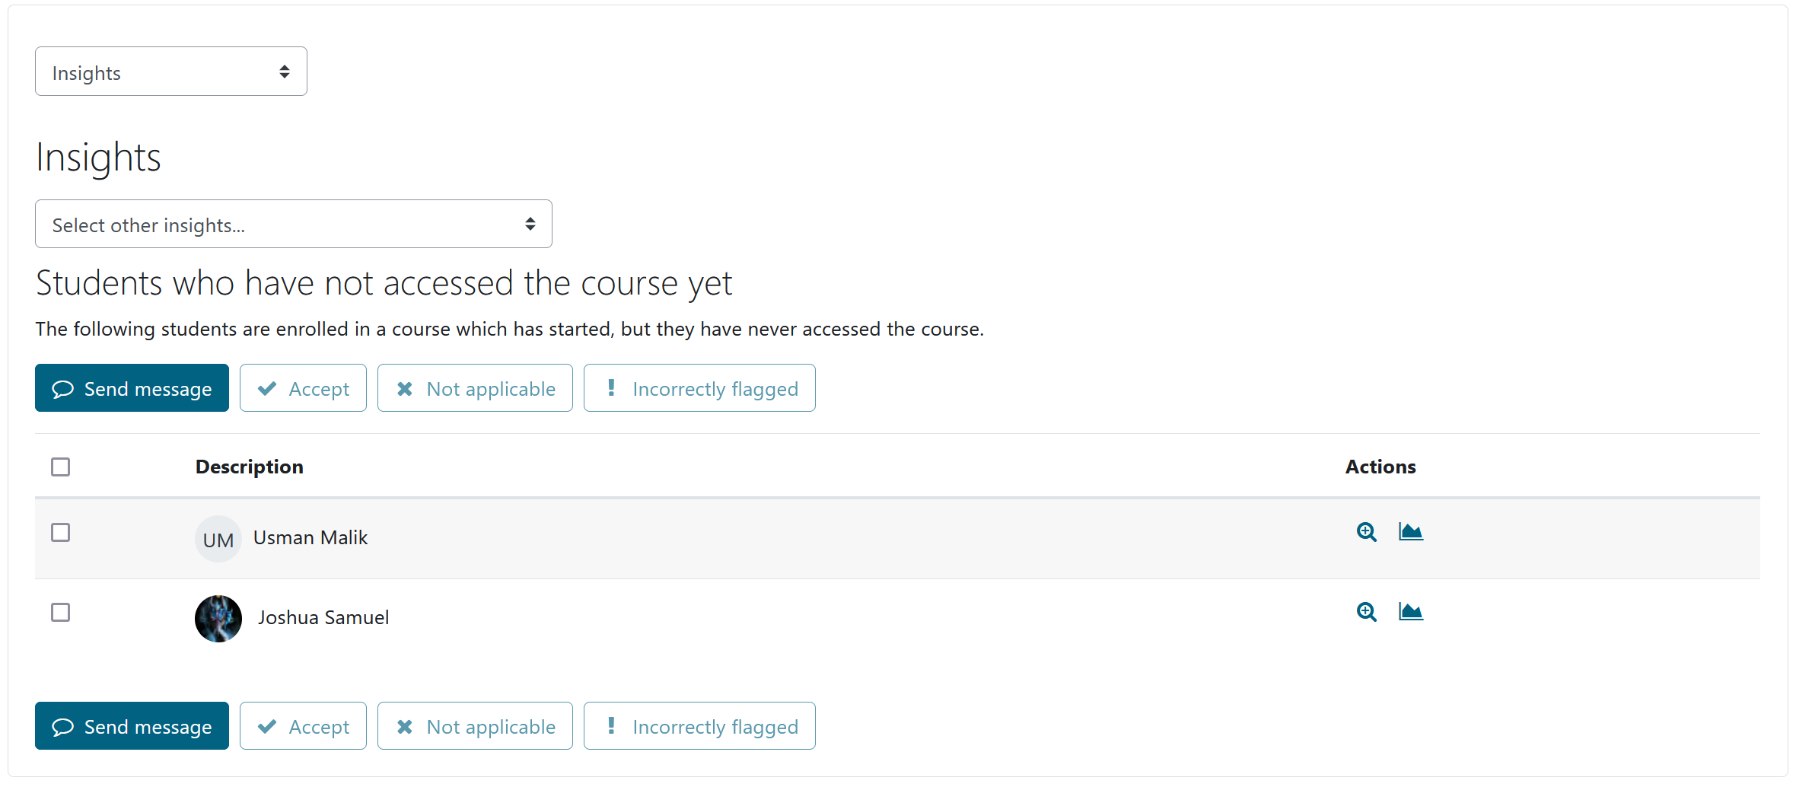
Business concept
Using our next-generation data architecture, we help organisations virtually manage agile workflows. We thrive because of our market knowledge and the great team behind our product.
20XX
Contoso business plan
9
Notes:
9

Slide 10
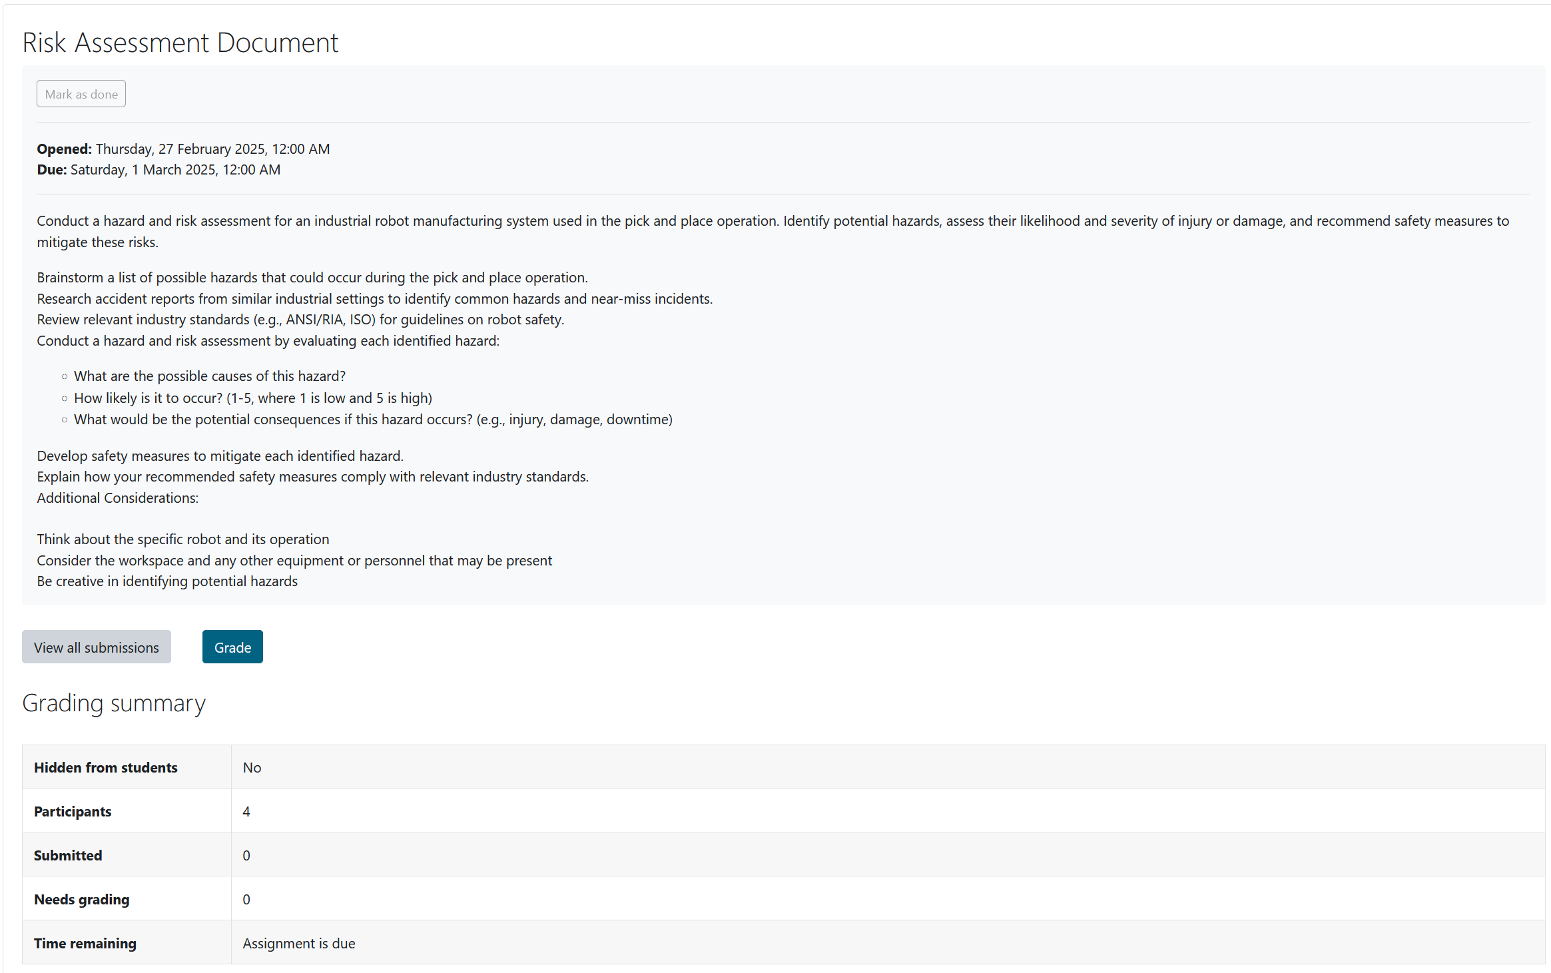

Risks and rewards
Risks
Rewards
New feature updates may not be popular with customers
Lack of staffing in key roles could delay product launch
Product will have more features which may require additional learning for customers
First on the market
Good publicity for the product so far, and we can build momentum from that scenario
Product testing with high-value clients have shown no issues
20XX
Contoso business plan
10
Notes:
10

